Slide 1

Micro-focus Adjustment

Slide 2

Auto Focus Systems
fo·cus (fks)
n. pl. fo·cus·es or fo·ci (-s, -k)
1.a. A point at which rays of light or other radiation converge or from which they appear to diverge, as after refraction or reflection in an optical system: the focus of a lens. Also called focal point.
2.a. The distinctness or clarity of an image rendered by an optical system.
b. The state of maximum distinctness or clarity of such an image:

Slide 3
Background
Modern digital cameras generally provide two modes of focus: Manual Focus and Auto Focus
Manual focus allows the photographer to control the focus of the image
Auto focus systems allow the camera to focus with little to no input by the photographer
A camera’s auto focus system adjusts the camera lens to obtain focus of the subject. This is accomplished by the camera’s computer analyzing the image and driving the lens in the correct direction to achieve focus

Slide 4
Available on ALL Cameras?
Most (NEWER) DSLR and Mirrorless cameras offer contrast, phase detection, or both auto focus systems
NIKON: D4, D3X, D3S, D3, D810, D800, D750, D700, D610, D600
CANON: 1DX, 1DE, 1D4 1DsMk3, 5D2, 5D3, 50D, 7D
PENTAX: K20
SONY: A900
Others may support it, check your manual
NOTE: Generally used on Camera Phones (contrast)

Slide 5
How Does It Work?
Light enters the camera through the lens, passing through a series of micro-lenses that separate the beam of light and pass the light on to the focus sensors and the pentaprism (eye piece)
Two major types of Auto Focus system
Contrast Detection
Phase Shift Detection

Slide 6
Contrast Detection
Measures the contrast between pixels on the sensor, the mirror is moved out of the way
Most camera’s utilize contrast detection as the primary focus system or in conjunction with Phase Detection
Generally used in “live view” or video modes
Generally is slower than Phase Detection systems
Can be ineffective in poor/low light conditions

Slide 7
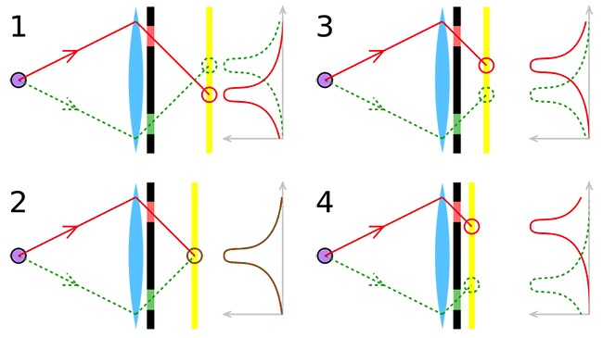
Phase Detection
Light enters the camera where it is split up into two images that are compared against each other

Slide 8
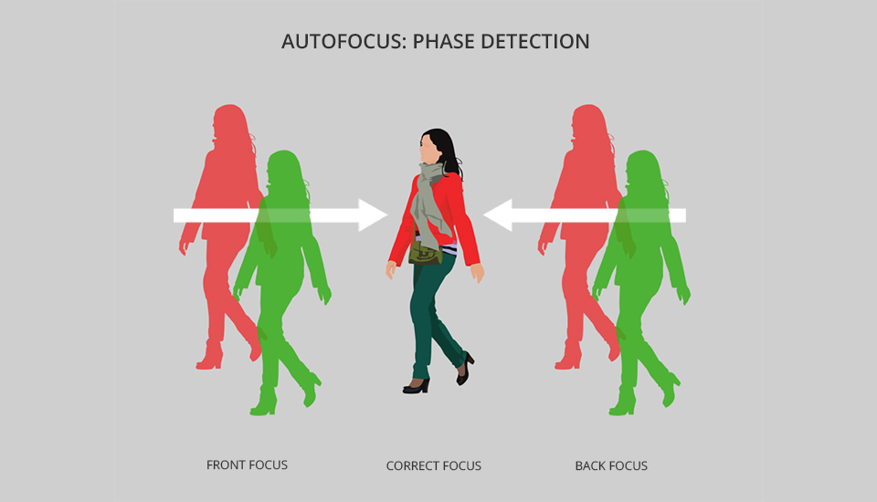
Phase Detection Sample

Slide 9
Phase Detection (cont)
The mirror remains down until the shutter is triggered
Performs a physical measurement, making it very precise
Can be used to correct a camera & lens that are not perfectly matched (micro-focus adjustment)
Uses multiple sensor types to improve auto focus

Slide 10
Auto Focus Modes
Single shot
The camera focus system obtains focus once and then remains off until the shutter button is pressed again
Continuous or AI-Servo
The camera focus system remains on while the shutter button is depressed and constantly adjusts the lens to maintain a focused image

Slide 11
In the Field
Still Photos
Portraits – single focus mode often adjusted to the eye of the subject
Useful for studio shots
Landscapes – single focus mode – adjust the focus point to the main subject
Action Photos
The camera constantly adjusts the focus of the subject while in motion
The photographer may be able to select the focus points used to enhance the focus process

Slide 12
Wrapping It Up
Study the manual that came with your camera to understand what type of Auto Focus system your camera uses
Most cameras allow you to move the focus point around
Remember – some lenses will limit your camera’s focus points and could impact your overall Auto Focus system – read the instruction manual for the lens also

